Slide 1



BILLY NO WEIGHTS
RUAIRIDH TAYLOR

Slide 2
The Brief
Solo Project
OOP programming
CRUD functionality

Slide 3
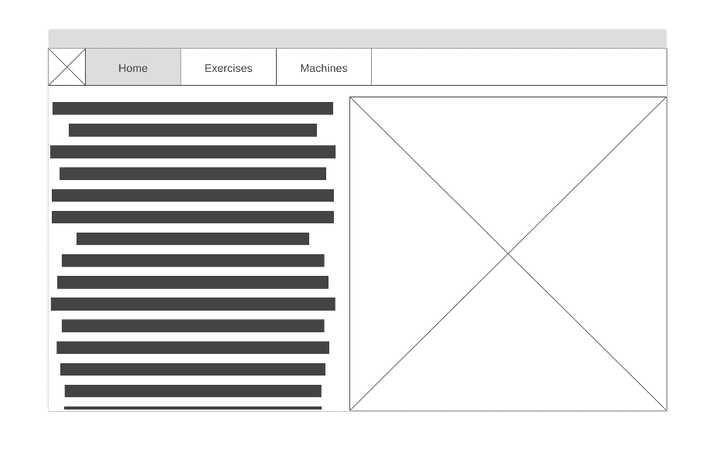
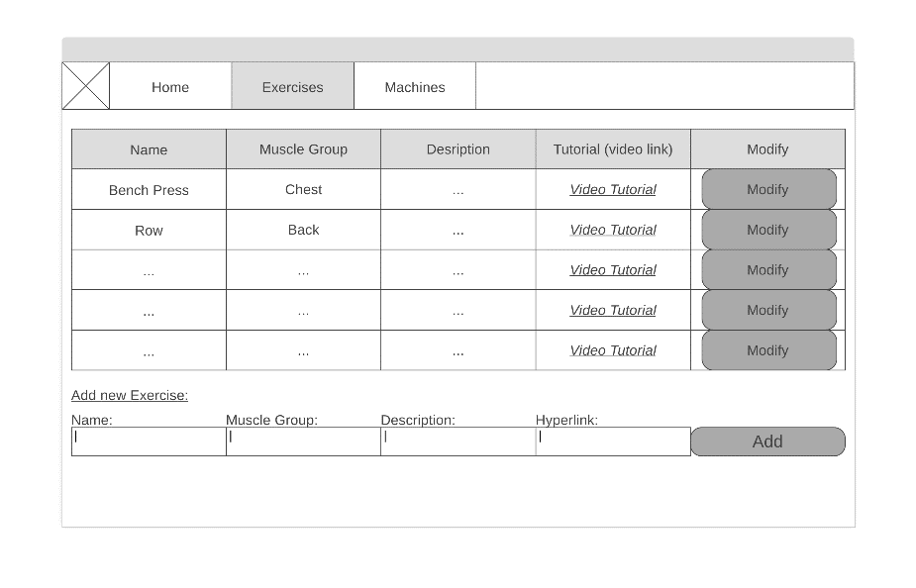
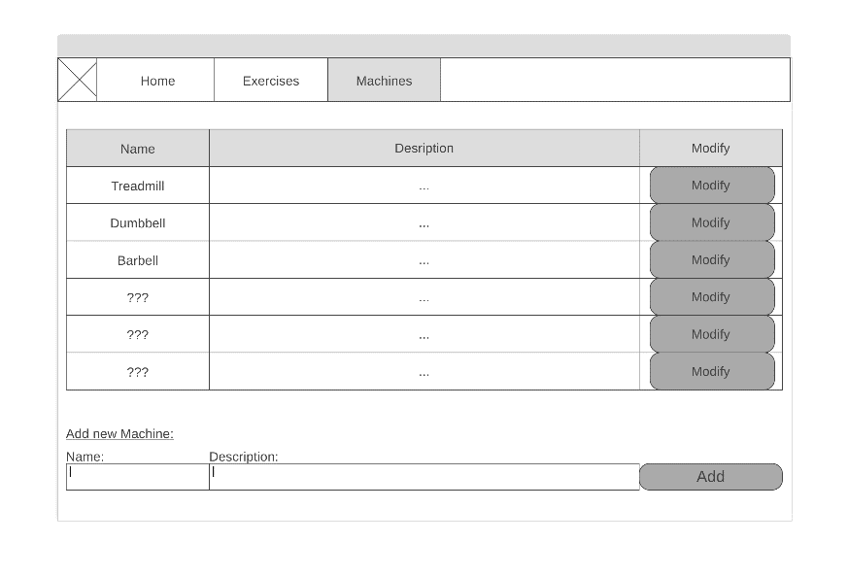
Proposed Solution

Slide 4
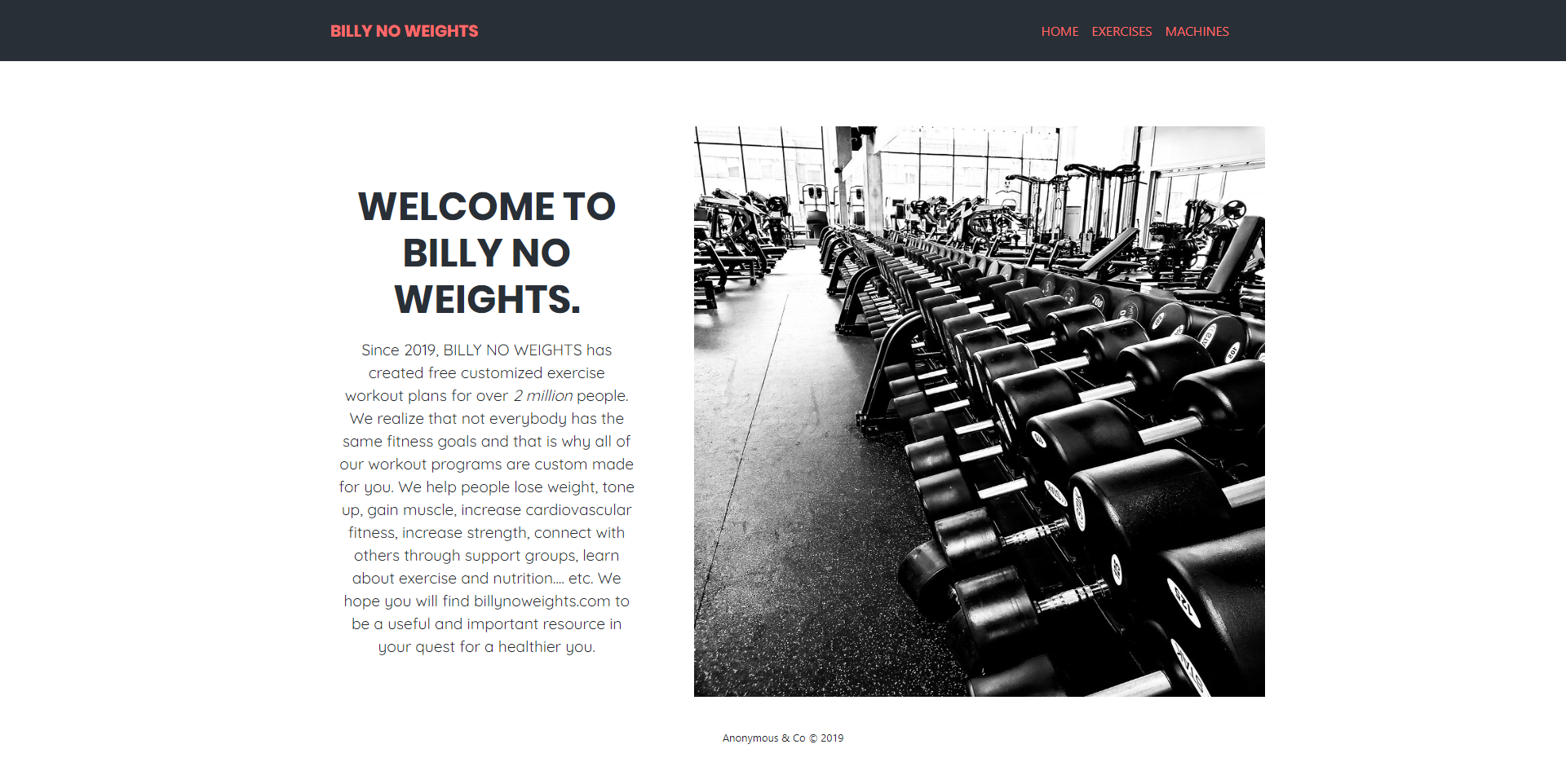
Solution

Slide 5
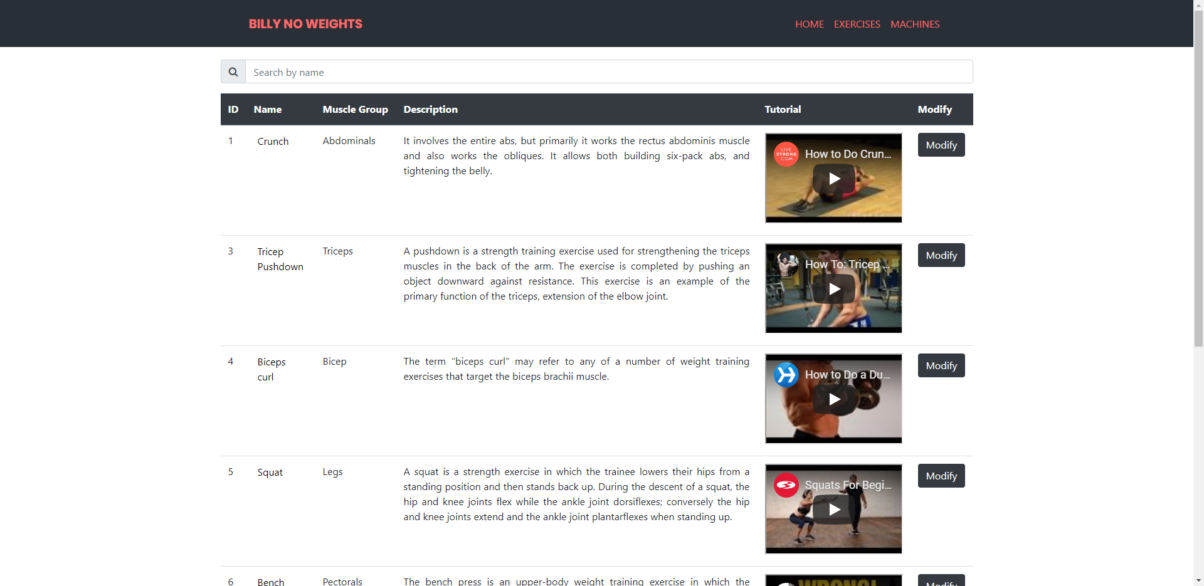
Solution

Slide 6
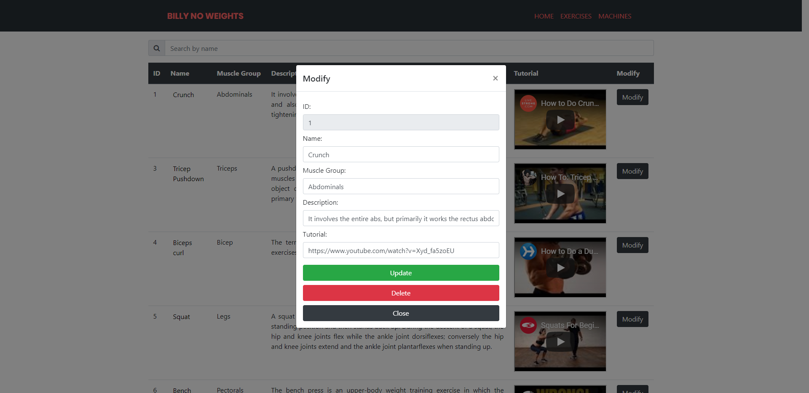
Solution

Slide 7
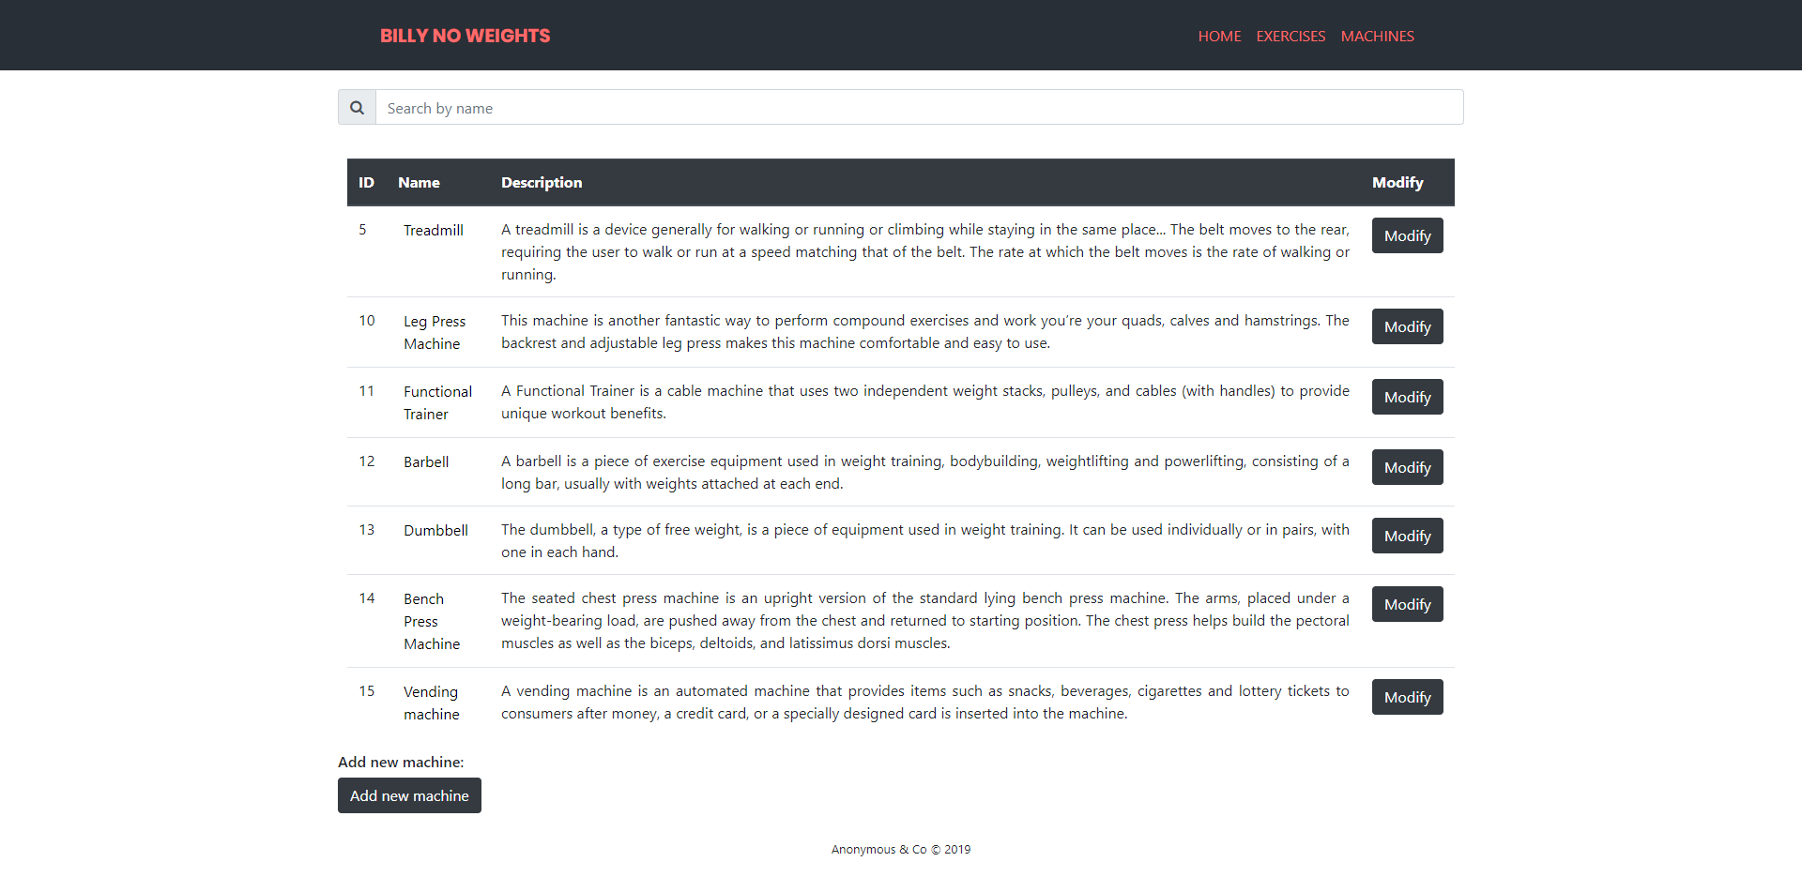
Solution

Slide 8
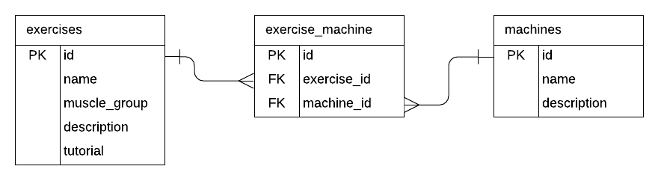
Entity Relationship Diagram

Slide 9
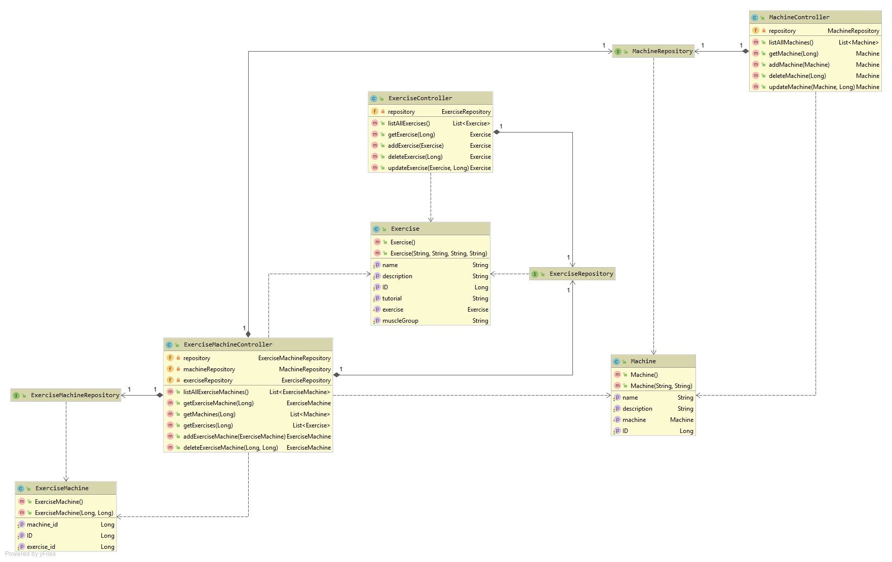
UML Class Diagram

Slide 10
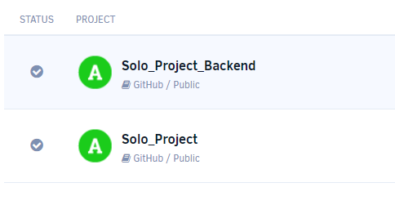
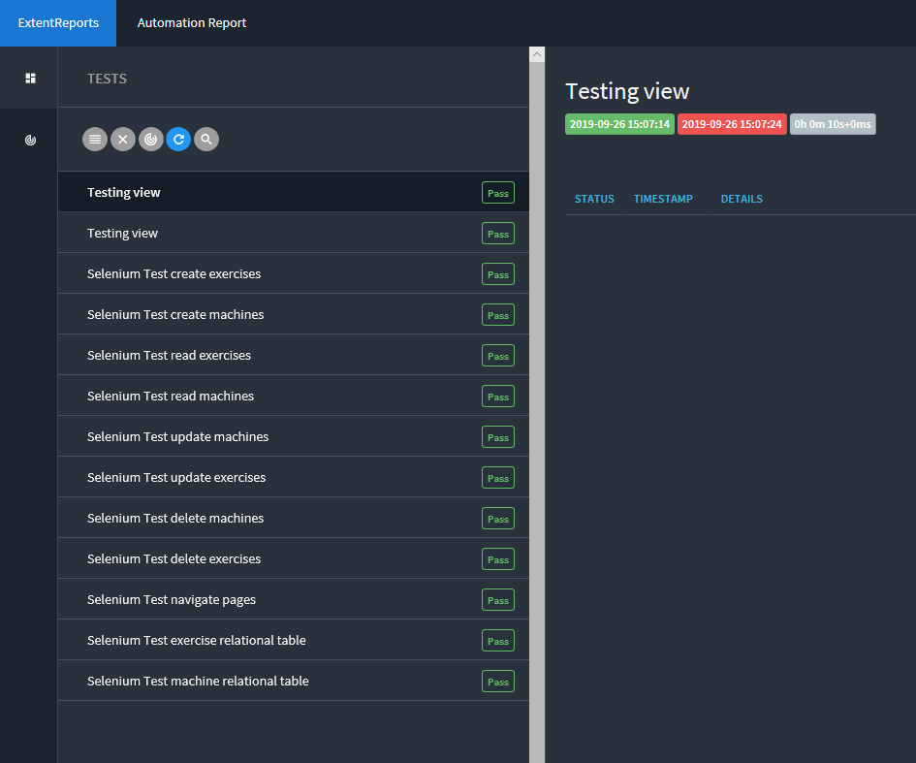
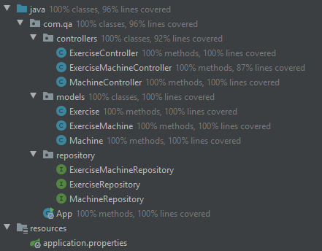
Testing

Slide 11
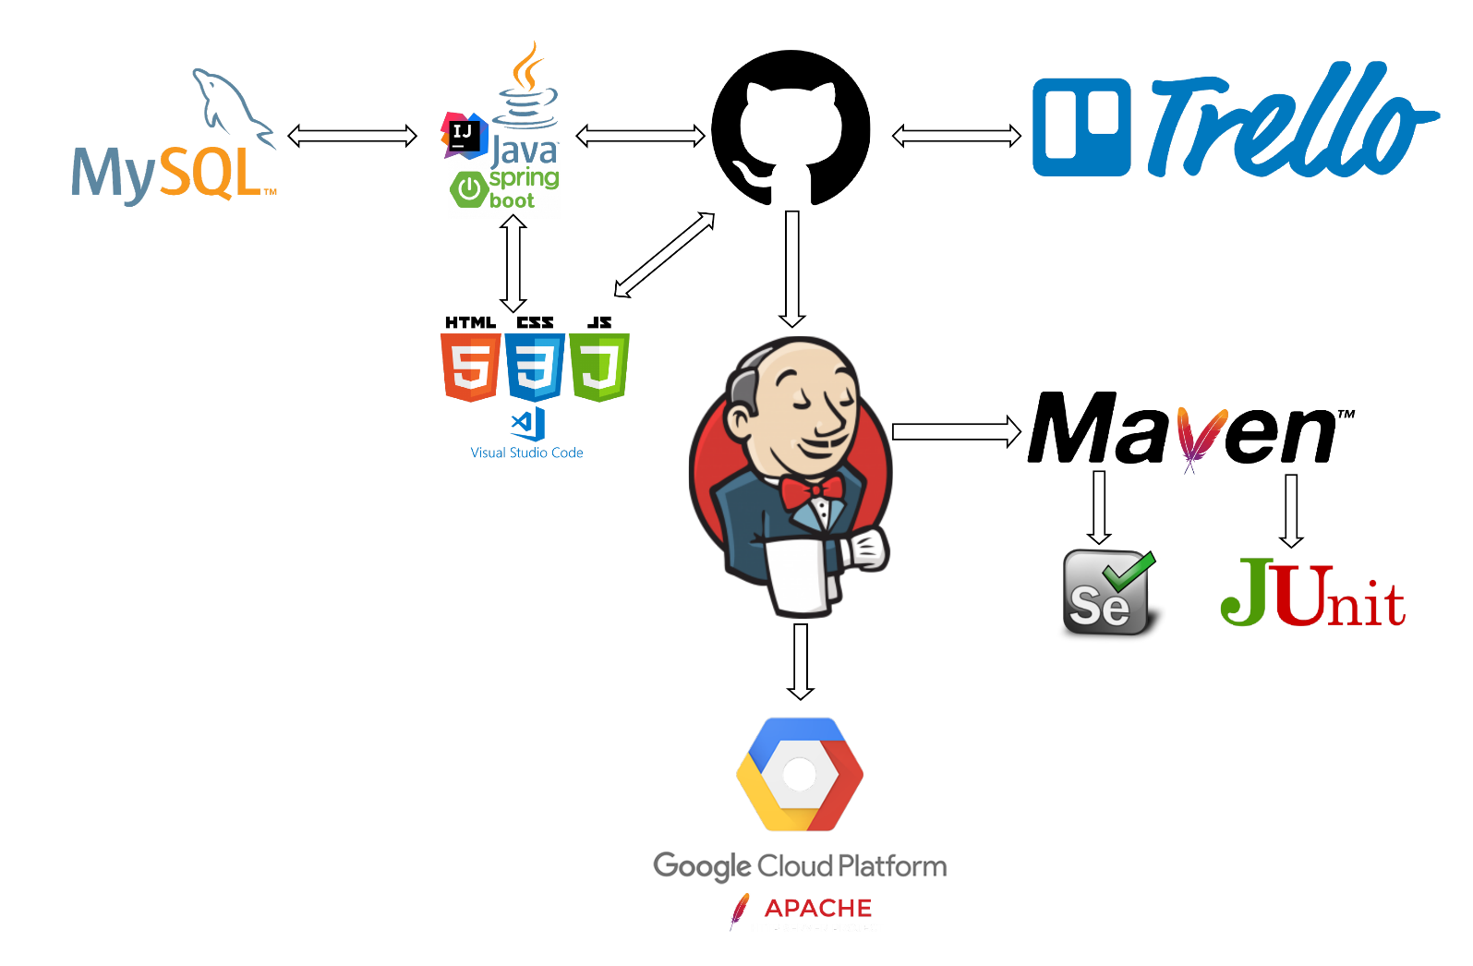
Technologies Used & DevOps Pipeline
MySQL
Java
JavaScript
HTML, CSS
Apache2
Jenkins
Maven
Git
Trello
GCP

Slide 12
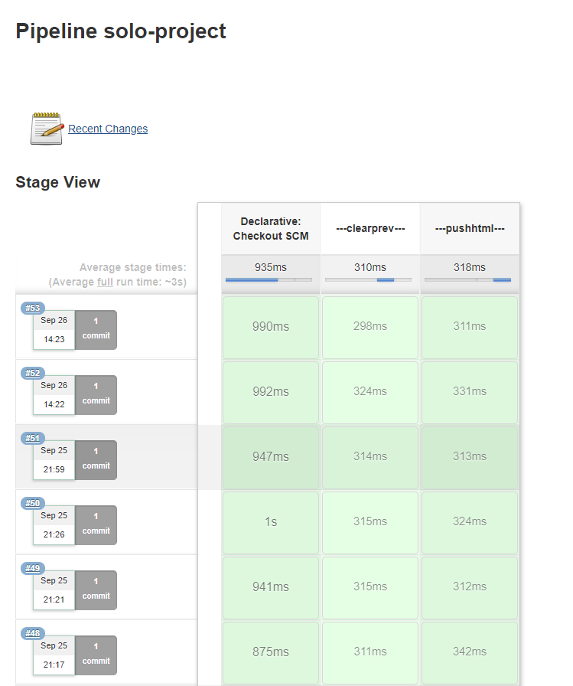
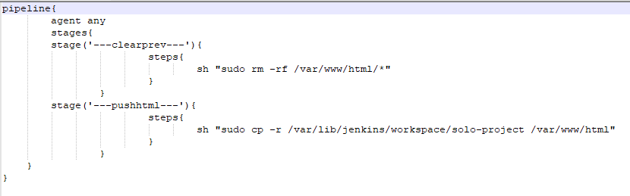
Continuous Integration

Slide 13
Summary
What went well
Relational database
Website looks professional
Improvements for the future:
Reduce the amount of code replication
Implement Docker

Slide 14
Demonstration

Slide 15
Any Questions?
Pls no

